Slide 1
REAL-TIME LAN-BASED
QUEUING MANAGEMENT &
STATISTICAL REPORTING
SYSTEM
FOR THE BPL-LIEO OF LGU ROSARIO, LA UNION
Tandas, Rojean F.
Barbosa, Manrijan M.
Estrelles, Carren Nicole A.
Garcia , John David R.
Rulloda, Jade Allysa V.
Don Mariano Marcos Memorial State University - South La Union Campus
Notes:
Good morning, everyone.
We are the presenters Module IV, Lesson 1 of Information, Assurance, and Security
And today, we are going to tackle about the topic Privacy Policy

Slide 2
Situation Analysis: The Current State
The Context: BPL-LIEOs accommodate a massive influx of clients during peak business registration and renewal periods.
The Current Method: Heavy reliance on manual queuing and verbal calling.
The Bottlenecks:
  Disorganized client flow and overcrowding.
  Client uncertainty regarding queue position.
  Staff difficulty in simultaneously processing documents, managing the line, and tracking skipped or returning clients.
Notes:
So, ano nga ba ang Privacy Policy?
Well, according to this slide, Privacy Policy is [Read]
Let me translate it in Filipino:
A Privacy Policy is a statement or legal document na nag-eexplain kung paano nangongolekta, ginagamit, dini-disclose, at mina-manage ng isang organization ang personal data ng mga customers, clients, o employees.
Ibig sabihin, dito nakasulat kung paano nila hinahandle ang mga impormasyon tulad ng:
Name
Address
Email
Phone number
Age, sex, marital status
Race, nationality, at pati religious beliefs.
In short, ito ang dokumento na nagsasabi kung paano nila pinoprotektahan o ginagamit ang ating personal na impormasyon.

Slide 3
Situation Analysis: The Research Gap
The Assumption: Many assume any generic, off-the-shelf queuing system (like in banks or fast food) can work for a government office.
The Reality: Generic systems lack the flexibility to handle the unique, multi-stage workflow of the Rosario BPL-LIEO.
Specific Missing Features in Generic Systems:
  They don't differentiate between New vs. Renewal workflows at the point of ticket generation.
  They lack a structured mechanism for handling clients with incomplete requirements who must return the next day.
  There is no localized, real-time tracking of complex transaction statuses.
Notes:
So, ano nga ba ang Privacy Policy?
Well, according to this slide, Privacy Policy is [Read]
Let me translate it in Filipino:
A Privacy Policy is a statement or legal document na nag-eexplain kung paano nangongolekta, ginagamit, dini-disclose, at mina-manage ng isang organization ang personal data ng mga customers, clients, o employees.
Ibig sabihin, dito nakasulat kung paano nila hinahandle ang mga impormasyon tulad ng:
Name
Address
Email
Phone number
Age, sex, marital status
Race, nationality, at pati religious beliefs.
In short, ito ang dokumento na nagsasabi kung paano nila pinoprotektahan o ginagamit ang ating personal na impormasyon.

Slide 4
Situation Analysis: Our Edge
Workflow-Specific Ticket Generation: Immediately categorizes clients (New vs. Renewal) ensuring they are routed to the correct service process.
"Return Tomorrow" & Priority Handling: A built-in feature specifically designed for the LGU reality. Clients lacking documents can return the next day and be automatically prioritized by staff without creating a new bottleneck.
LAN-Based Reliability: Unlike cloud-based web apps, our system operates entirely on a Local Area Network (LAN). It guarantees 100% uptime even during external internet outages, a critical requirement for continuous LGU operations.
Data-Driven Governance: It doesn't just manage lines; the Statistical Reporting Module translates raw queue data into actionable insights (peak hours, staff performance) for LGU administrators.
Notes:
So, ano nga ba ang Privacy Policy?
Well, according to this slide, Privacy Policy is [Read]
Let me translate it in Filipino:
A Privacy Policy is a statement or legal document na nag-eexplain kung paano nangongolekta, ginagamit, dini-disclose, at mina-manage ng isang organization ang personal data ng mga customers, clients, o employees.
Ibig sabihin, dito nakasulat kung paano nila hinahandle ang mga impormasyon tulad ng:
Name
Address
Email
Phone number
Age, sex, marital status
Race, nationality, at pati religious beliefs.
In short, ito ang dokumento na nagsasabi kung paano nila pinoprotektahan o ginagamit ang ating personal na impormasyon.

Slide 5
Situation Analysis: Our Edge
Workflow-Specific Ticket Generation: Immediately categorizes clients (New vs. Renewal) ensuring they are routed to the correct service process.
"Return Tomorrow" & Priority Handling: A built-in feature specifically designed for the LGU reality. Clients lacking documents can return the next day and be automatically prioritized by staff without creating a new bottleneck.
LAN-Based Reliability: Unlike cloud-based web apps, our system operates entirely on a Local Area Network (LAN). It guarantees 100% uptime even during external internet outages, a critical requirement for continuous LGU operations.
Data-Driven Governance: It doesn't just manage lines; the Statistical Reporting Module translates raw queue data into actionable insights (peak hours, staff performance) for LGU administrators.
Notes:
So, ano nga ba ang Privacy Policy?
Well, according to this slide, Privacy Policy is [Read]
Let me translate it in Filipino:
A Privacy Policy is a statement or legal document na nag-eexplain kung paano nangongolekta, ginagamit, dini-disclose, at mina-manage ng isang organization ang personal data ng mga customers, clients, o employees.
Ibig sabihin, dito nakasulat kung paano nila hinahandle ang mga impormasyon tulad ng:
Name
Address
Email
Phone number
Age, sex, marital status
Race, nationality, at pati religious beliefs.
In short, ito ang dokumento na nagsasabi kung paano nila pinoprotektahan o ginagamit ang ating personal na impormasyon.

Slide 6
Statement of Objectives
General Objective: To design and implement a Real-Time LAN-Based Queuing Management and Statistical Reporting System specifically adapted for the Rosario BPL-LIEO.
Specific Objectives:
  To design and develop an automated LAN-based system (Ticket Generator, Staff Dashboard, Public Monitor, Admin Analytics).
  To test and improve system performance via alpha and beta testing.
  To assess software quality based on ISO/IEC 25010 Standards.
Notes:
So, ano nga ba ang Privacy Policy?
Well, according to this slide, Privacy Policy is [Read]
Let me translate it in Filipino:
A Privacy Policy is a statement or legal document na nag-eexplain kung paano nangongolekta, ginagamit, dini-disclose, at mina-manage ng isang organization ang personal data ng mga customers, clients, o employees.
Ibig sabihin, dito nakasulat kung paano nila hinahandle ang mga impormasyon tulad ng:
Name
Address
Email
Phone number
Age, sex, marital status
Race, nationality, at pati religious beliefs.
In short, ito ang dokumento na nagsasabi kung paano nila pinoprotektahan o ginagamit ang ating personal na impormasyon.

Slide 7
Research Design
Developmental Research: Systematically designing, building, and refining the queuing software to directly solve the operational bottlenecks of the BPL-LIEO.
Descriptive Research: Utilized to objectively evaluate the system's quality and gather quantitative feedback from both staff and citizens compared to their experience with the manual method.
Notes:
So, ano nga ba ang Privacy Policy?
Well, according to this slide, Privacy Policy is [Read]
Let me translate it in Filipino:
A Privacy Policy is a statement or legal document na nag-eexplain kung paano nangongolekta, ginagamit, dini-disclose, at mina-manage ng isang organization ang personal data ng mga customers, clients, o employees.
Ibig sabihin, dito nakasulat kung paano nila hinahandle ang mga impormasyon tulad ng:
Name
Address
Email
Phone number
Age, sex, marital status
Race, nationality, at pati religious beliefs.
In short, ito ang dokumento na nagsasabi kung paano nila pinoprotektahan o ginagamit ang ating personal na impormasyon.

Slide 8
Materials and Procedure: Tools & Tech Stack
Hardware Environment: Local Area Network (LAN) setup using standard Laptops, Ticket Printers, and Smart TVs.
Software Staack:
  Frontend: React.js, HTML5, Vanilla CSS
  Backend: Node.js with Express.js
  Database: Prisma ORM with SQLite
  Real-time Communication: Socket.io
Notes:
So, ano nga ba ang Privacy Policy?
Well, according to this slide, Privacy Policy is [Read]
Let me translate it in Filipino:
A Privacy Policy is a statement or legal document na nag-eexplain kung paano nangongolekta, ginagamit, dini-disclose, at mina-manage ng isang organization ang personal data ng mga customers, clients, o employees.
Ibig sabihin, dito nakasulat kung paano nila hinahandle ang mga impormasyon tulad ng:
Name
Address
Email
Phone number
Age, sex, marital status
Race, nationality, at pati religious beliefs.
In short, ito ang dokumento na nagsasabi kung paano nila pinoprotektahan o ginagamit ang ating personal na impormasyon.

Slide 9
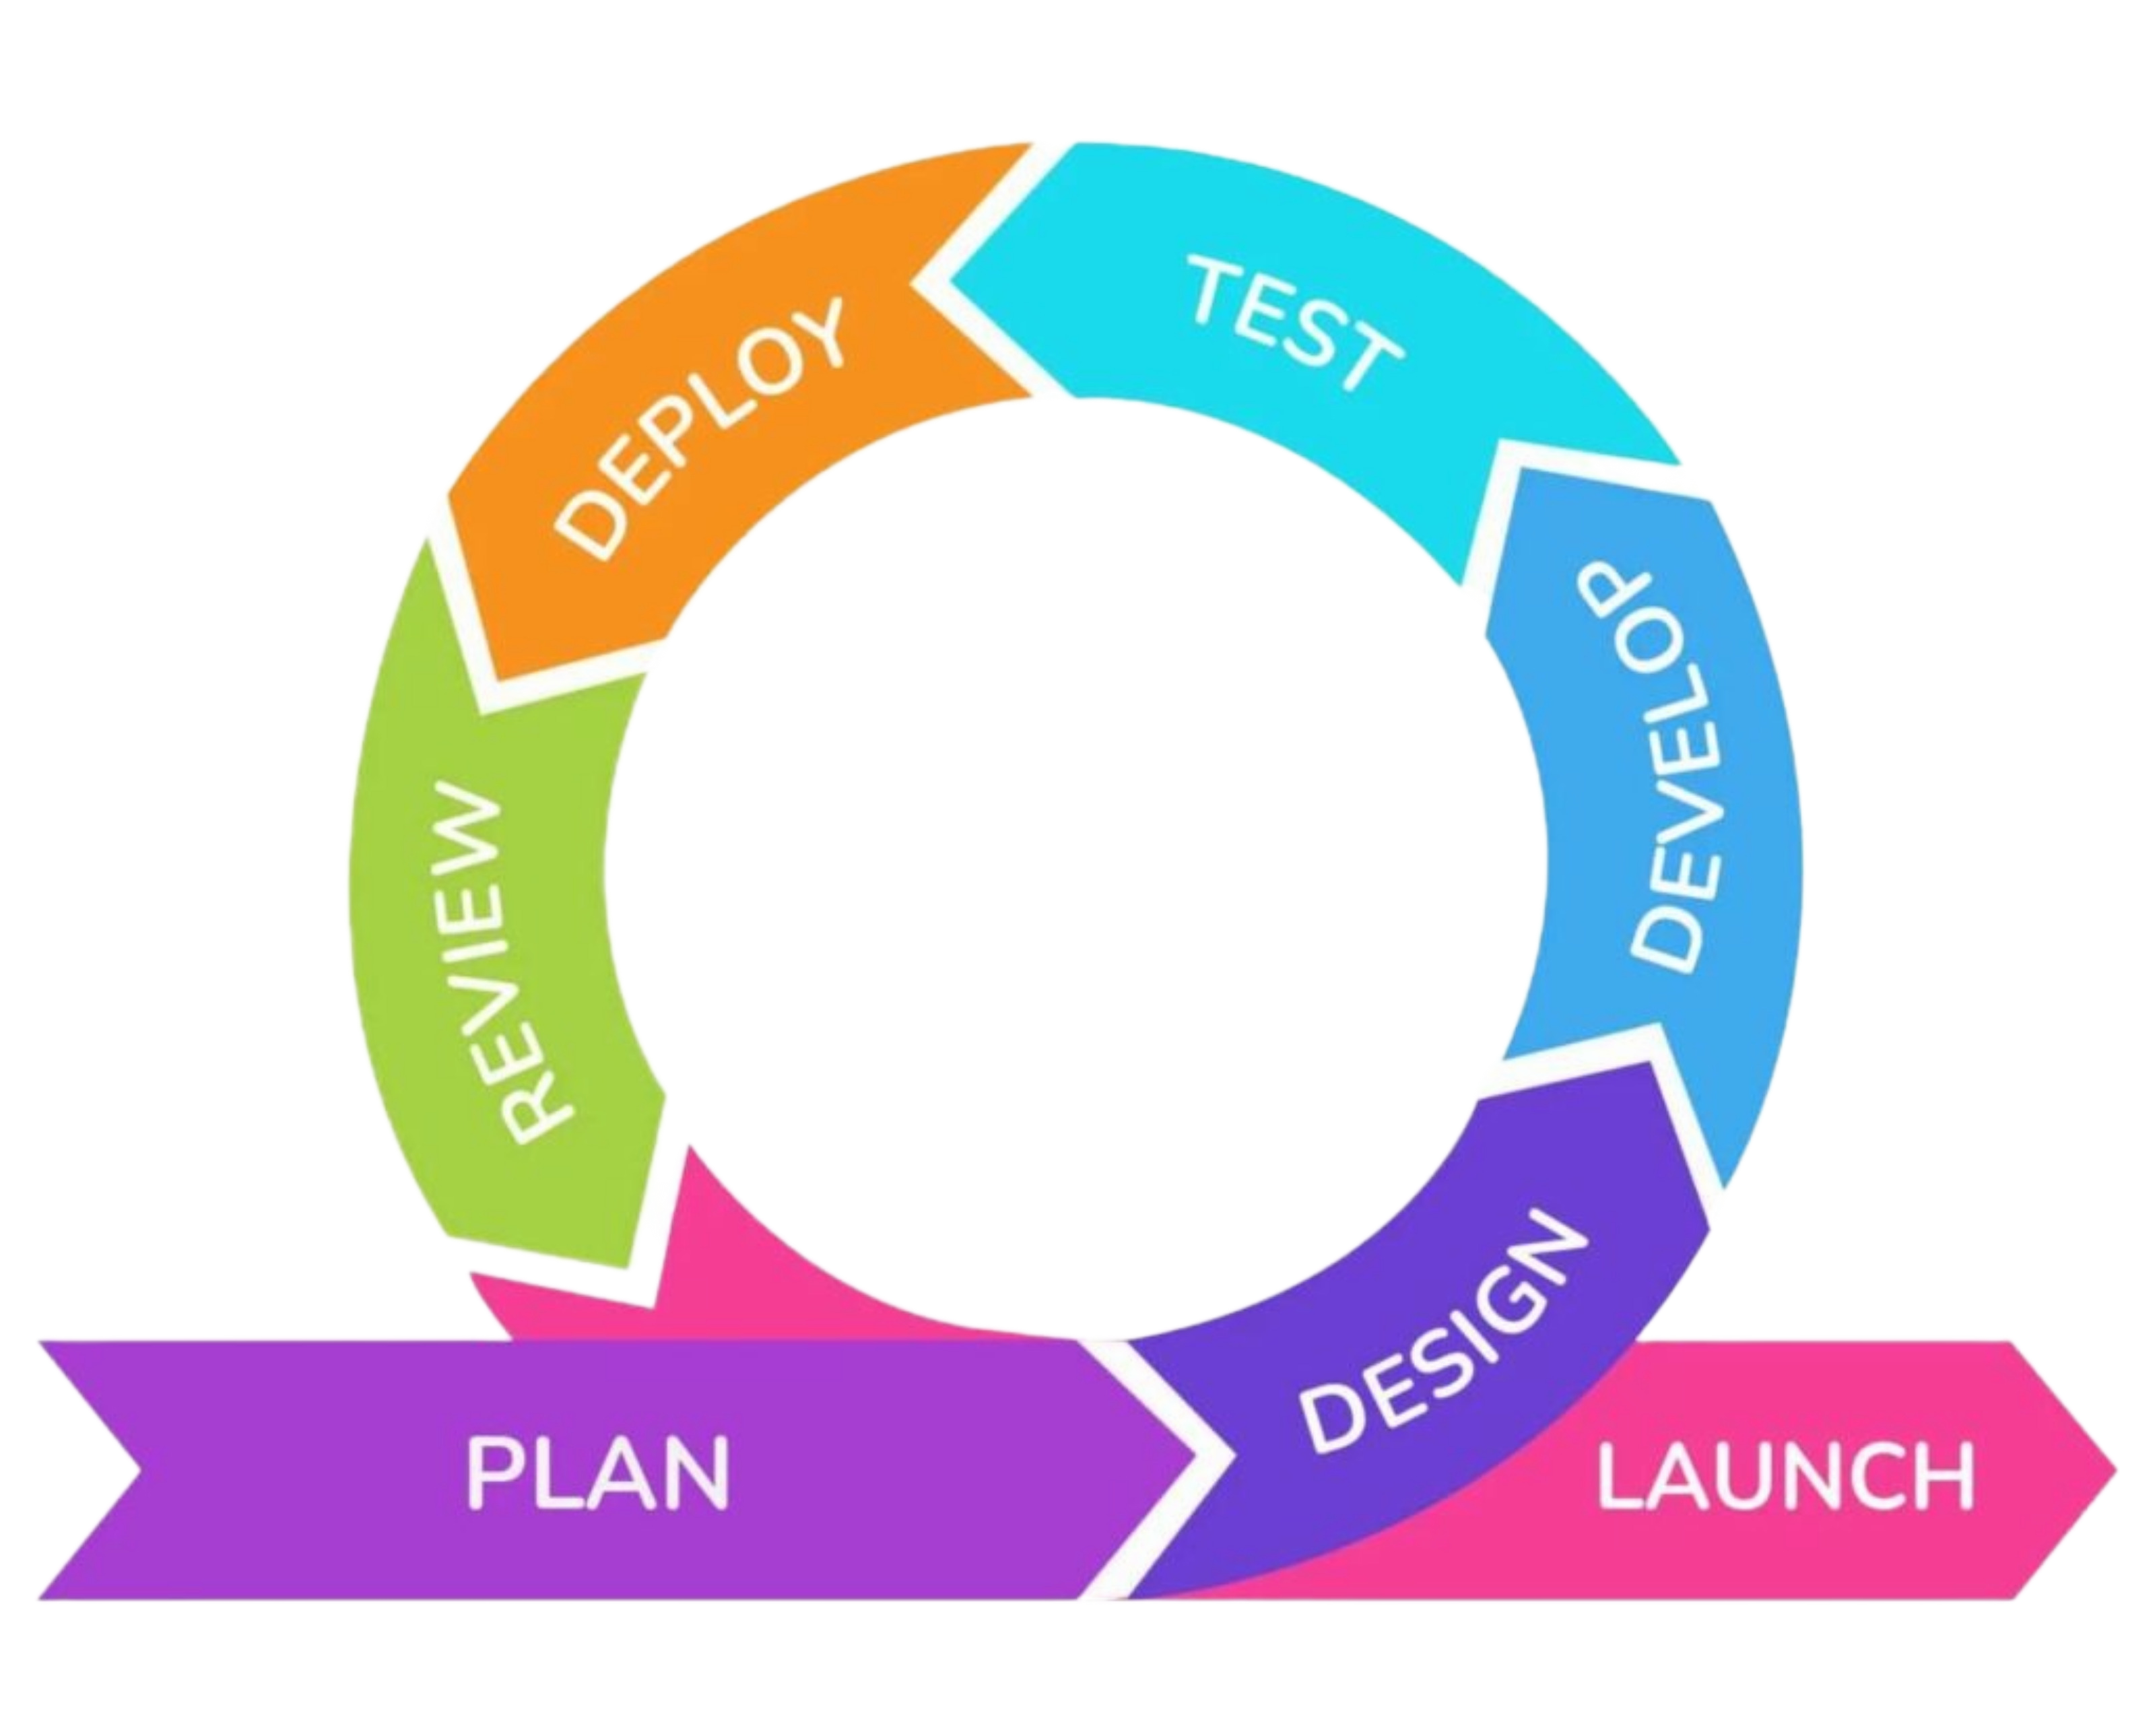
Materials and Procedure: SDLC
Approach: Agile Software Development Life Cycle (SDLC).
Why Agile? It allows us to build the system incrementally in sprints, ensuring we can easily adapt the software based on direct feedback from BPL-LIEO personnel during development.
Phases: Plan, Design, Develop, Test, Deploy and Review.
Notes:
So, ano nga ba ang Privacy Policy?
Well, according to this slide, Privacy Policy is [Read]
Let me translate it in Filipino:
A Privacy Policy is a statement or legal document na nag-eexplain kung paano nangongolekta, ginagamit, dini-disclose, at mina-manage ng isang organization ang personal data ng mga customers, clients, o employees.
Ibig sabihin, dito nakasulat kung paano nila hinahandle ang mga impormasyon tulad ng:
Name
Address
Email
Phone number
Age, sex, marital status
Race, nationality, at pati religious beliefs.
In short, ito ang dokumento na nagsasabi kung paano nila pinoprotektahan o ginagamit ang ating personal na impormasyon.

Slide 10
Materials and Procedure: System Design
Visualizing the Solution:
  BPMN Diagram: Maps the step-by-step physical and digital interactions from the citizen's arrival to departure.
  Entity-Relationship Diagrams (ERD): Ensuring robust transaction data storage.
  Data Flow & Use-Case Diagrams: Defining clear roles for Citizens vs. Staff.
Notes:
So, ano nga ba ang Privacy Policy?
Well, according to this slide, Privacy Policy is [Read]
Let me translate it in Filipino:
A Privacy Policy is a statement or legal document na nag-eexplain kung paano nangongolekta, ginagamit, dini-disclose, at mina-manage ng isang organization ang personal data ng mga customers, clients, o employees.
Ibig sabihin, dito nakasulat kung paano nila hinahandle ang mga impormasyon tulad ng:
Name
Address
Email
Phone number
Age, sex, marital status
Race, nationality, at pati religious beliefs.
In short, ito ang dokumento na nagsasabi kung paano nila pinoprotektahan o ginagamit ang ating personal na impormasyon.

Slide 11
Materials and Procedure: Testing Procedures
Continuous Testing: Ensuring code quality and real-time Socket.io stability.
Alpha Testing: Conducted in a controlled lab environment by developers to iron out initial logic and UI bugs.
Beta Testing: The crucial phase, deployed on the actual BPL-LIEO LAN environment and tested by actual personnel to validate network performance and usability under real-world conditions.
Notes:
So, ano nga ba ang Privacy Policy?
Well, according to this slide, Privacy Policy is [Read]
Let me translate it in Filipino:
A Privacy Policy is a statement or legal document na nag-eexplain kung paano nangongolekta, ginagamit, dini-disclose, at mina-manage ng isang organization ang personal data ng mga customers, clients, o employees.
Ibig sabihin, dito nakasulat kung paano nila hinahandle ang mga impormasyon tulad ng:
Name
Address
Email
Phone number
Age, sex, marital status
Race, nationality, at pati religious beliefs.
In short, ito ang dokumento na nagsasabi kung paano nila pinoprotektahan o ginagamit ang ating personal na impormasyon.

Slide 12
Data Gathered
Assessment Tool: A customized survey questionnaire based on the ISO/IEC 25010 Software Quality Model (adapted from Malaya et al., 2022).
Respondents (Total N = 60):
  BPL-LIEO Staff: 10 respondents (Total Enumeration) - evaluating operational efficiency and staff controls.
  Citizens / Clients: 50 respondents (Convenience Sampling) - evaluating public monitor visibility and process transparency.
Notes:
So, ano nga ba ang Privacy Policy?
Well, according to this slide, Privacy Policy is [Read]
Let me translate it in Filipino:
A Privacy Policy is a statement or legal document na nag-eexplain kung paano nangongolekta, ginagamit, dini-disclose, at mina-manage ng isang organization ang personal data ng mga customers, clients, o employees.
Ibig sabihin, dito nakasulat kung paano nila hinahandle ang mga impormasyon tulad ng:
Name
Address
Email
Phone number
Age, sex, marital status
Race, nationality, at pati religious beliefs.
In short, ito ang dokumento na nagsasabi kung paano nila pinoprotektahan o ginagamit ang ating personal na impormasyon.

Slide 13
Data Analysis
Statistical Tool: Weighted Mean
Evaluation Scale: 5-point Likert Scale assessing seven ISO/IEC 25010 characteristics (Functionality, Usability, Efficiency, Reliability, Security, Maintainability, Portability).
Goal: To determine the descriptive equivalent rating (from Poor to Excellent) and definitively prove the system's acceptability and superiority over the manual method.
Notes:
So, ano nga ba ang Privacy Policy?
Well, according to this slide, Privacy Policy is [Read]
Let me translate it in Filipino:
A Privacy Policy is a statement or legal document na nag-eexplain kung paano nangongolekta, ginagamit, dini-disclose, at mina-manage ng isang organization ang personal data ng mga customers, clients, o employees.
Ibig sabihin, dito nakasulat kung paano nila hinahandle ang mga impormasyon tulad ng:
Name
Address
Email
Phone number
Age, sex, marital status
Race, nationality, at pati religious beliefs.
In short, ito ang dokumento na nagsasabi kung paano nila pinoprotektahan o ginagamit ang ating personal na impormasyon.

